Slide 1


Slide 2

A Real-Time IoT’s Attacks Detection System for Large-Scale Anomalies Using Auxiliary Classifier Generative Adversarial Networks
Muhammad Nauman Hameed
(Registration No. CS320212005)
MS Scholar
Institute of Computing
Kohat University of Science and Technology
Supervisors
Dr. M. Irfan Uddin
Assistant Professor
Institute of Computing, KUST
Dr. M. Muneer Umar
Lecturer
Institute of Computing, KUST

Slide 3
OUTLINE
Introduction
Literature Review
OBJECTIVES
Proposed Model
PROBLEM STATEMENT
Results

Slide 4

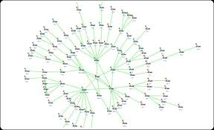

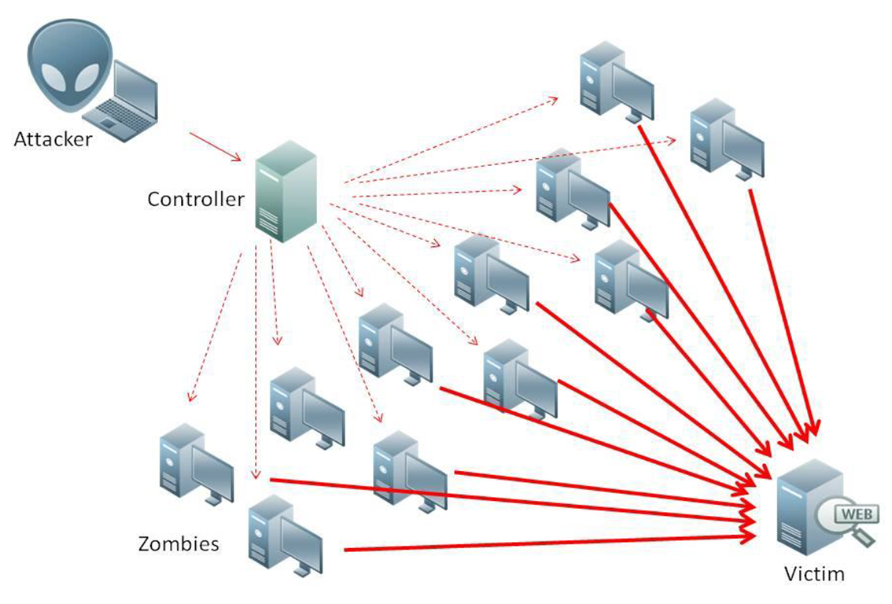

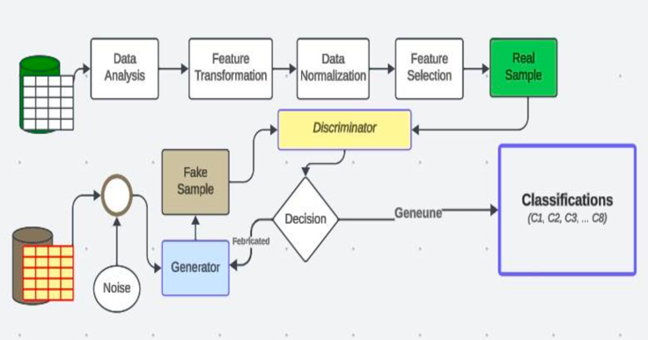
INTRODUCTION
Internet of Things
Massive Traffic
Abnormal Traffic
Security Attacks
Detection Mechanisms
AC-GAN Based Detection

Slide 5
Internet of Things
Connects devices via the internet.
Automates everyday tasks.
Collects and analyzes data through sensors.
Enables remote control of devices.
Powers smart homes, cities, and industries.

Slide 6
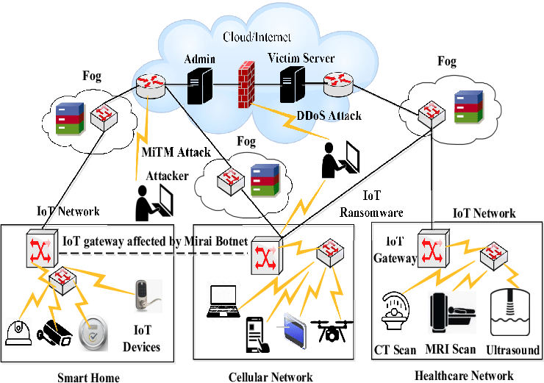
MASSIVE LEVEL OF DATA TRAFFIC

Slide 7
Massive Data Traffic
High data volume
Increased network congestion
Privacy Risks
Challenges in real-time monitoring
Elevated Security concerns
Risk of anomalies and irregularities

Slide 8

Normal and Abnormal IoT Traffic
Normal Traffic
Legitimate and expected device behavior.
Consistent patterns, no anomalies.
Examples: Scheduled data uploads, regular sensor readings.
Abnormal Traffic
Deviates from normal patterns.
Irregular, excessive, or unauthorized activity.
Examples: DDoS attacks, data exfiltration, botnet behavior.
Key Goal: Differentiate to detect and mitigate IoT attacks.

Slide 9
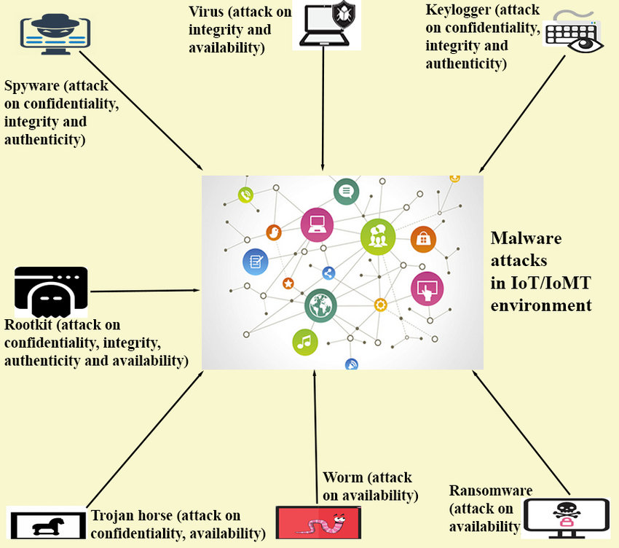
Abnormal IoT Traffic is a sign of Security Attacks

Slide 10
Effect of Abnormal IoT Traffic
Unexpected, Risky and Unsecure environment
Disruptions in device fictionality
Data integrity and privacy concerns
Data and device Privacy issues
Degraded Server/ Network Performance

Slide 11
RELATED LITERATURE
ML Techniques to Detect IoT Attacks.
DNN Base System[1]
ACGAN Base System[10]
GAN Base System[6]
CGAN Base System[4]

Slide 12
LITERATURE REVIEW
Article | Contribution | Limitations
Al Mamoori et al. (2023),[1] | The proposed framework for anomaly detection in IoT networks with heterogeneous devices. The framework is based on a denoising autoencoder, which is used as a building block in the DNN. | The proposed framework is based on a denoising autoencoder, which has been adopted as a building block in the Deep Neural Networks.
Walid Saad et al. (2019),[2] | Distributed generative adversarial network (GAN) is proposed to provide a fully distributed IDS for the IoT so as to detect anomalous behavior without reliance on any centralized controller. | GANs may suffer from mode collapse, where the generator produces limited variations of outputs, potentially leading to a lack of diversity in generated samples.

Slide 13
LITERATURE REVIEW
Article | Contribution | Limitations
Akramul Azim et al. (2020),[3] | To solve the challenge of data imbalance in anomaly detection tasks and present a novel framework for anomaly detection. | CGAN generating limited variations and potentially missing certain types of anomalies.
Pu Wang et al. (2019),[4] | An abnormality detection framework for electrocardiogram (ECG) signals, which owns unbalance distribution among different classes and gaining high accuracy. | In this paper ACGAN Model is used for heartbeat arrhythmias detection framework.

Slide 14
PROBLEM STATEMENT
IoT traffic records reveal diverse patterns, creating an unbalanced dataset vulnerable to network attacks.
Dynamic Traffic Patterns: IoT's ever-changing network traffic challenges traditional detection methods.
Imbalanced Data Struggles: Real-time analysis and imbalanced data hinder current AI solutions in IoT security.
Enhanced Accuracy with GANs: Utilizing generative adversarial networks (GANs) offers a promising approach to improve threat detection in IoT networks

Slide 15

OBJECTIVES
To develop an AI-based model using GAN to enhance IoT traffic anomaly detection.
To classify the normal and abnormal traffic patterns within IoT networks.
To handle imbalanced and large-scale IoT traffic datasets effectively.
To improve the accuracy of anomaly and threat detection in the IoT ecosystem.

Slide 16
Proposed Model
Workflow diagram of a Real-Time IoT’s Attack Detection System for Large-Scale Anomalies

Slide 17
Feature Selection for Attack Detection
FEATURE NAME | IMPORTANT AND IMPACT
Source IP Address | Identifies the origin of network traffic. Deviations from normal source addresses might indicate spoofing or unauthorized access attempts.
Destination IP Address | Identifies the intended recipient of network traffic. Unusual destination addresses can suggest targeted attacks or compromised devices.
Protocol Type (TCP, UDP, etc.) | Different protocols have varying functionalities. Unexpected protocol usage for specific communication channels might indicate attacks exploiting vulnerabilities in certain protocols.
Port Numbers | Ports are used for specific services. Anomalies in port usage, like accessing services through unusual ports, can be indicative of attacks attempting to bypass security measures.
Packet Size | Deviations from typical packet sizes can be a sign of anomalies. For example, unusually large packets might be used in flooding attacks, while fragmented packets could be used for evasion techniques.
Number of Packets in Flow | Significant changes in the number of packets within a flow compared to normal network activity could suggest attacks like DoS or DDoS attempts.
Flow Duration | Unexpectedly long or short flow durations compared to baseline traffic patterns might indicate abnormal communication behavior.

Slide 18
Feature Selection for Attack Detection
FEATURE NAME | IMPORTANT AND IMPACT
Inter-Packet Arrival Times (if available) | Deviations from the usual time intervals between packets in a flow can suggest attempts to manipulate communication patterns or exploit timing-based vulnerabilities.
Flag Counts (SYN, FIN, RST, etc.) | Counts of various TCP flags can help identify attack patterns. For example, high SYN flag counts might suggest SYN floods, while frequent FIN scans can be indicative of port scanning attacks.
Statistical Measures (Min, Max, Avg, Std of Packet Length) | These measures help quantify traffic characteristics. Minimum and maximum packet lengths can reveal anomalies, while average and standard deviation provide insights into the overall distribution of packet sizes.
Application Protocol Indicators (HTTP, HTTPS, DNS, etc.) | These indicators can highlight specific types of traffic and potential attack vectors. While initially considered low priority, their importance might be reevaluated based on domain knowledge about targeted attack types.
Advanced Metrics (Covariance, Variance, Weight of Packet Lengths) | These metrics provide deeper insights into traffic flow structure. Their inclusion depends on computational resources and the complexity desired in the model. They can be explored for further feature selection if initial model performance warrants it.

Slide 19
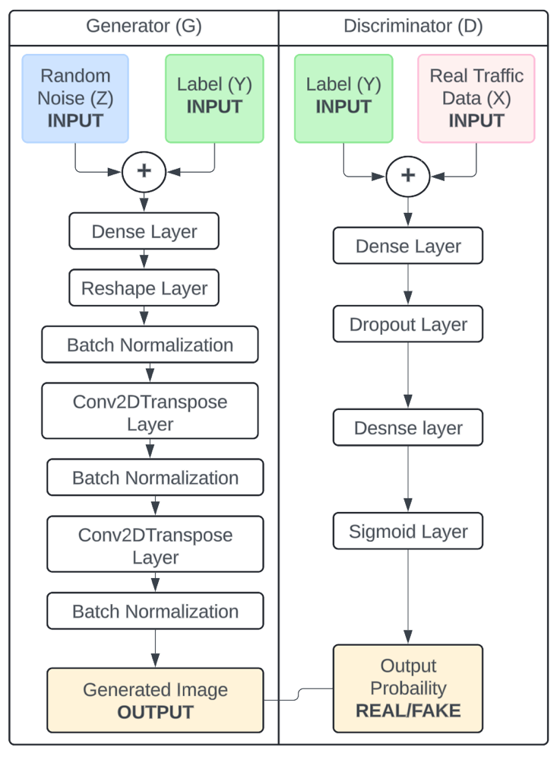
How does the system Work?

Slide 20

Results

Slide 21
Dataset Used for the Proposed System
Type | Target | Total Number of Records | Class Distribution
Benign | Benign | 1,098,195 | 2.35%
DDoS | Attack | 33,984,560 | 72.79%
DoS | Attack | 8,090,738 | 17.33%
Mirai | Attack | 2,634,124 | 5.64%
Recon | Attack | 354,565 | 0.76%
Spoofing | Attack | 486,504 | 1.04%
Web | Attack | 24,829 | 0.05%
Bruteforce | Attack | 13,064 | 0.03%
Total |  | 46,686,579

Slide 22
Detections Metrics
Traffic Class | Precision | Recall | F1 Score | Accuracy
DDoS-ICMP_Flood | 0.99839628 | 0.9966768 | 0.9975358 | 0.99552308
DDoS-UDP_Flood | 0.97714729 | 0.9984619 | 0.98768961 | 0.99155971
DDoS-TCP_Flood | 0.99093629 | 0.99261527 | 0.99177507 | 0.98386313
DDoS-PSHACK_Flood | 0.9999618 | 0.99946544 | 0.99971356 | 0.99946282
DDoS-SYN_Flood | 0.99589291 | 0.98761149 | 0.99173491 | 0.98434867
DDoS-RSTFINFlood | 0.99235125 | 0.99152291 | 0.99193691 | 0.99852426
DDoS-SynonymousIP_Flood | 0.99996178 | 0.99885466 | 0.99940791 | 0.99887028
DoS-UDP_Flood | 0.99546794 | 0.99897062 | 0.9972162 | 0.99496724
DDoS-UDP_Fragmentation | 0.99962194 | 0.98104861 | 0.99024819 | 0.99027075
DDoS-ACK_Fragmentation | 0.96451005 | 0.98809524 | 0.9761602 | 0.98718642
DNS_Spoofing | 0.99967581 | 0.99914232 | 0.99940899 | 0.99886913
DoS-TCP_Flood | 0.98017688 | 0.96836397 | 0.97423462 | 0.98071688
DoS-SYN_Flood | 0.99222798 | 0.91926686 | 0.95435497 | 0.99407962
BenignTraffic | 0.99881211 | 0.99966032 | 0.99923603 | 0.99853122
Mirai-greeth_flood | 0.99133414 | 0.99025229 | 0.99079292 | 0.98723885
Mirai-udpplain | 0.99827348 | 0.99125664 | 0.99475269 | 0.99847744
Mirai-greip_flood | 0.99806921 | 0.93463143 | 0.9653092 | 0.9841883
DDoS-ICMP_Fragmentation | 0.99950403 | 0.99879444 | 0.99914911 | 0.99870559
MITM-ArpSpoofing | 0.99524624 | 0.93581262 | 0.96461482 | 0.95175879
DDoS-HTTP_Flood | 0.98379301 | 0.96472884 | 0.97416766 | 0.98808867
DDoS-SlowLoris | 0.99569335 | 0.99442098 | 0.99505676 | 0.99091092
DictionaryBruteForce | 0.99797894 | 0.92625136 | 0.96077829 | 0.9827985

Slide 23
Accuracy

Slide 24
REFRENCES
[1] A. Abusitta, G. H. de Carvalho, O. A. Wahab, T. Halabi, B. C. Fung, and S. Al Mamoori, “Deep learning-enabled anomaly detection for iot systems,”Internet of Things, vol. 21, p. 100656, 2023.
[2] A. Ferdowsi and W. Saad, “Generative adversarial networks for distributed intrusion detection in the internet of things,” in 2019 IEEE Global Commu- nications Conference (GLOBECOM). IEEE, 2019, pp. 1–6.
[3] O. M. Ezeme, Q. H. Mahmoud, and A. Azim, “Design and development of ad-cgan: Conditional generative adversarial networks for anomaly detection,” IEEE Access, vol. 8, pp. 177 667–177 681, 2020.
[4] P. Wang, B. Hou, S. Shao, and R. Yan, “Ecg arrhythmias detection using auxiliary classifier generative adversarial network and residual network,” Ieee Access, vol. 7, pp. 100 910–100 922, 2019.

Slide 25

Muhammad Nauman Hameed (MS Scholar )
Institute of Computing KUST
Registration No CS320211005
naumanhameed149@gmail.com

